Slide 1
MATLAB ASSIGNMENT
PREPARED BY GROUP 15

Slide 2
MEMBERS OF GROUP 15
NAME | REGISTRATION NUMBER | COURSE | GITHUB LINK
Lugunga Timothy | BU/UG/2024/2679 | AMI | https://github.com/lugungatimothy848/lugungatimomatlab.git
Bahemuka Godwins | BU/UG/2024/2583 | APE | https://github.com/Godwins5/Gbahemuka.git
Katusiime Joel | BU/UP/2024/1031 | WAR | https://github.com/katusiimeJoel/Katusiime-Joel.git
Nabukwasi Shakira | BU/UP/2023/0862 | WAR | https://github.com/Shakira-ux/Nabukwasi-Shakira-.git
Naziwa Patricia | BU/UP/2024/0993 | PTI | https://github.com/naziwapatricia82-debug/Naziwa-Patricia-.git
Sidenya Kevin | BU/UP/2O24/3839 | WAR | https://github.com/Sidenya/Sidenya-repository.git
Odong Eric Perry | BU/UP/2024/1059 | WAR | https://github.com/erickperry08-hub/My-MATLAB-project.git
Nandijja Laila | BU/UP/2024/3833 | WAR | https://github.com/nandijjalaila4/2024-2025-nandijja-project.git
Namata Lilian Kizza | BU/UP/2024/0984 | MEB | https://github.com/Lillian401/Namata-Lillian-.git
Buluma Daniel | BU/UP/2024/4323 | AMI | https://github.com/Dan256-ami/Buluma-Daniel-.git

Slide 3
INTRODUCTION TO MATLAB
MATLAB, which stands for matrix laboratory, is a high-performance programming language and environment designed primarily for technical computing
The first version of MATLAB was created in Fortran in the late 1970s as a simple interactive matrix calculator. This early iteration was built on top of two significant mathematical libraries: LINPACK and EISPACK, which were developed for numerical linear algebra and eigenvalue problems, respectively.
MATLAB was officially launched as a commercial product in 1984 by MathWorks, a company founded by Moler along with Jack Little and Steve Bangert. The software was reimplemented in C, with the addition of user-defined functions, toolboxes, and graphical interfaces.
Recent versions of MATLAB have introduced features like the Live Editor, which allows users to create interactive documents that combine code, output, and formatted text. This evolution reflects MATLAB's ongoing adaptation to meet the needs of its diverse user base across academ

Slide 4
PART A
From the previous assignment of various numerical methods, ie Newton Raphson Method, secant method, bisector method and fixed point iteration method, we made equivalent code based on recursive programming.

Slide 5
NEWTON RAPHSON RECURSIVE
% newton_recursive.m
function newton_recursive()
tic;
% Parameters
f = @(x) x^3 - x - 2;
df = @(x) 3*x^2 - 1;
x0 = 2;
err = 5e-4;
max_iter = 100;
% Recursive Newton-Raphson
x = newton_recursive_func(f, df, x0, err, max_iter, 1);
% Results
time_taken = toc;
xref = fzero(f, 1.6);
fprintf('Root: %.4f\n', x);
fprintf('Reference root: %.4f\n', xref);
fprintf('Computation time: %.4f seconds\n', time_taken);
fprintf('Error: %.6f\n', abs(x - xref));
% Save results
save("newton_recursive.mat", "x", "time_taken", "xref");
end
function x = newton_recursive_func(f, df, x, err, max_iter, iter)
% Check maximum iterations
if iter > max_iter
warning('Maximum iterations reached');
x = NaN;
return;
end
% Newton-Raphson iteration
x_new = x - f(x)/df(x);
fprintf('Iteration %d: x = %.4f\n', iter, x_new);
% Check convergence
if abs(x_new - x) < err
x = x_new;
else
x = newton_recursive_func(f, df, x_new, err, max_iter, iter + 1);
end
end

Slide 6
SECANT RECURSIVE
% secant_recursive.m
function secant_recursive()
fprintf('=== Secant Method (Recursive) ===\n');
tic;
% Parameters
f = @(x) x^3 - x - 2;
x0 = 1;
x1 = 2;
err = 5e-4;
max_iter = 100;
% Recursive secant
x = secant_recursive_func(f, x0, x1, err, max_iter, 1);
% Results
time_taken = toc;
xref = fzero(f, 1.6);
fprintf('Root: %.4f\n', x);
fprintf('Reference root: %.4f\n', xref);
fprintf('Computation time: %.4f seconds\n', time_taken);
fprintf('Error: %.6f\n', abs(x - xref));
% Save results
save("secant_recursive.mat", "x", "time_taken", "xref");
end
function x = secant_recursive_func(f, x0, x1, err, max_iter, iter)
% Check maximum iterations
if iter > max_iter
warning('Maximum iterations reached');
x = NaN;
return;
end
% Secant iteration
f0 = f(x0);
f1 = f(x1);
x_new = x1 - f1*(x1 - x0)/(f1 - f0);
fprintf('Iteration %d: x = %.4f\n', iter, x_new);
% Check convergence
if abs(x_new - x1) < err
x = x_new;
else
x = secant_recursive_func(f, x1, x_new, err, max_iter, iter + 1);
end
end

Slide 7
BISECTION RECURSIVE
% bisection_recursive.m
function bisection_recursive()
fprintf('=== Bisection Method (Recursive) ===\n');
tic;
% Parameters
f = @(x) x^3 - x - 2;
a = 1;
b = 2;
err = 5e-4;
% Recursive bisection
x = bisection_recursive_func(f, a, b, err);
% Results
time_taken = toc;
xref = fzero(f, 1.6);
fprintf('Root: %.4f\n', x);
fprintf('Reference root: %.4f\n', xref);
fprintf('Computation time: %.4f seconds\n', time_taken);
fprintf('Error: %.6f\n', abs(x - xref));
% Save results
save("bisection_recursive.mat", "x", "time_taken", "xref");
end
function x = bisection_recursive_func(f, a, b, err)
c = (a + b) / 2;
% Base case
if (b - a) <= err
x = c;
return;
end
% Recursive case
if f(a) * f(c) < 0
x = bisection_recursive_func(f, a, c, err);
else
x = bisection_recursive_func(f, c, b, err);
end
end

Slide 8
FIXED POINT ITERATION RECURSIVE
% fixed_point_recursive.m
function fixed_point_recursive()
fprintf('=== Fixed Point Iteration (Recursive) ===\n');
tic;
% Parameters
f = @(x) x^3 - x - 2;
g = @(x) (x+2)^(1/3);
x0 = 1;
err = 5e-4;
max_iter = 100;
% Recursive fixed point
x = fixed_point_recursive_func(g, x0, err, max_iter, 1);
% Results
time_taken = toc;
xref = fzero(f, 1.6);
fprintf('Root: %.4f\n', x);
fprintf('Reference root: %.4f\n', xref);
fprintf('Computation time: %.4f seconds\n', time_taken);
fprintf('Error: %.6f\n', abs(x - xref));
% Save results
save("fixed_point_recursive.mat", "x", "time_taken", "xref");
end
function x = fixed_point_recursive_func(g, x, err, max_iter, iter)
% Check maximum iterations
if iter > max_iter
warning('Maximum iterations reached');
x = NaN;
return;
end
% Fixed point iteration
x_new = g(x);
fprintf('Iteration %d: x = %.4f\n', iter, x_new);
% Check convergence
if abs(x_new - x) < err
x = x_new;
else
x = fixed_point_recursive_func(g, x_new, err, max_iter, iter + 1);
end
end

Slide 9
EULER RECURSIVE
% euler_recursive.m
function euler_recursive()
fprintf('=== Euler Method (Recursive) ===\n');
% Parameters
m = 1; % mass of the ball (kg)
g = 9.8; % gravitational acceleration (m/s^2)
k = 0.2; % drag coefficient
dt = 0.1; % time step (s)
t_end = 10; % total time (s)
% Initialization
t0 = 0; % initial time
v0 = 0; % initial velocity
% Calculate number of steps
num_steps = ceil(t_end / dt);
t = zeros(1, num_steps + 1);
v = zeros(1, num_steps + 1);
t(1) = t0;
v(1) = v0;
fprintf('Parameters:\n');
fprintf('Mass: %.1f kg\n', m);
fprintf('Gravity: %.1f m/s²\n', g);
fprintf('Drag coefficient: %.1f\n', k);
fprintf('Time step: %.1f s\n', dt);
fprintf('Total time: %.1f s\n', t_end);
fprintf('Number of steps: %d\n', num_steps);
% Start timing
tic;
% Recursive Euler method
[t, v] = euler_recursive_func(m, g, k, dt, t, v, t0, t_end, 1);
% Stop timing
computation_time = toc;
% Display results
fprintf('\nResults:\n');
fprintf('Final velocity: %.4f m/s\n', v(end));
fprintf('Computation time: %.4f seconds\n', computation_time);
fprintf('Number of steps: %d\n', num_steps);
% Plotting the results
figure;
plot(t, v, 'b-', 'LineWidth', 2);
xlabel('Time (s)');
ylabel('Velocity (m/s)');
title('Velocity of the Ball Over Time (Recursive Euler Method)');
grid on;

Slide 10
EULER RECURSIVE CONT.
% Add analytical solution for comparison
hold on;
v_analytical = (g/k) * (1 - exp(-k*t));
plot(t, v_analytical, 'r--', 'LineWidth', 1.5);
legend('Euler Method', 'Analytical Solution', 'Location', 'southeast');
% Calculate and display error
final_error = abs(v(end) - v_analytical(end));
fprintf('Final velocity error: %.6f m/s\n', final_error);
% Close extra figures if more than 10 are open
figHandles = findobj('Type', 'figure');
if length(figHandles) > 10
close(figHandles(1:end-10));
end
% Save results
save("euler_recursive.mat", "t", "v", "computation_time", "num_steps", "final_error");
end
function [t, v] = euler_recursive_func(m, g, k, dt, t, v, current_time, t_end, step)
% Base case: if current time exceeds end time, return
if current_time >= t_end
return;
end
% Calculate next time step
next_time = current_time + dt;
% Euler method step
dvdt = g - k * v(step); % compute the derivative
v(step + 1) = v(step) + dvdt * dt; % update velocity
t(step + 1) = next_time; % update time
% Display progress for first few steps
if step <= 5
fprintf('Step %d: t = %.1f s, v = %.4f m/s\n', step, t(step), v(step));
elseif step == 6
fprintf('...\n');
end
% Recursive call for next step
[t, v] = euler_recursive_func(m, g, k, dt, t, v, next_time, t_end, step + 1);
end

Slide 11
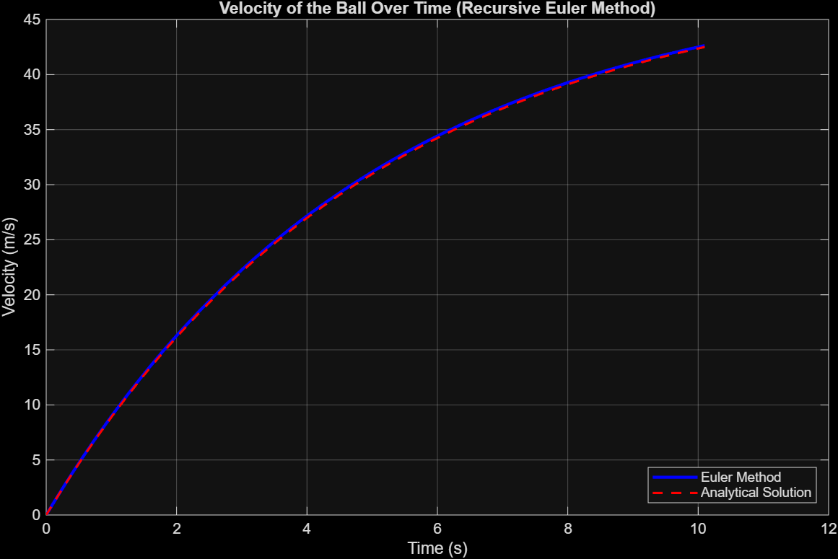
EULER RECURSIVE GRAPH

Slide 12
RUNGE KUTTA RECURSIVE
% runge_kutta_recursive.m
function runge_kutta_recursive()
fprintf('=== Runge-Kutta Method (Recursive) ===\n');
tic;
% Parameters
f = @(t, v) 9.8 - 0.2*v;
t0 = 0;
v0 = 0;
h = 2;
tn = 50;
% Initialize arrays
n = ceil((tn - t0)/h);
t = zeros(1, n+1);
v = zeros(1, n+1);
t(1) = t0;
v(1) = v0;
% Recursive Runge-Kutta
[t, v] = rk2_recursive_func(f, t, v, t0, tn, h, 1);
% Results
time_taken = toc;
fprintf('Final velocity: %.4f m/s\n', v(end));
fprintf('Computation time: %.4f seconds\n', time_taken);
fprintf('Number of steps: %d\n', n);
% Plot results
figure;
plot(t, v, 'b-', 'LineWidth', 2);
xlabel('Time (s)');
ylabel('Velocity (m/s)');
title('Velocity of the Ball Over Time (Recursive RK2)');
grid on;
% Save results
save("runge_kutta_recursive.mat", "t", "v", "time_taken");
end
function [t, v] = rk2_recursive_func(f, t, v, t_current, t_end, h, step)
% Base case
if t_current >= t_end
return;
end
% Runge-Kutta 2nd order
k1 = h * f(t_current, v(step));
k2 = h * f(t_current + h, v(step) + k1);
v(step + 1) = v(step) + 0.5 * (k1 + k2);
t(step + 1) = t_current + h;
fprintf('Step %d: t = %.1f, v = %.4f\n', step, t(step), v(step));
% Recursive call
[t, v] = rk2_recursive_func(f, t, v, t_current + h, t_end, h, step + 1);
end

Slide 13
RUNGE KUTTA RECURSIVE GRAPH

Slide 14
FIBONACCI RECURSIVE
% fibonacci_recursive.m
function fibonacci_recursive()
fprintf('=== Fibonacci Problem (Recursive) ===\n');
% Test different n values
n_values = [10, 15, 20, 25, 30];
times = zeros(size(n_values));
fib_values = zeros(size(n_values));
for i = 1:length(n_values)
n = n_values(i);
fprintf('\nCalculating F(%d)...\n', n);
tic;
fib_val = fibonacci_recursive_func(n);
time_taken = toc;
times(i) = time_taken;
fib_values(i) = fib_val;
fprintf('F(%d) = %d\n', n, fib_val);
fprintf('Computation time: %.6f seconds\n', time_taken);
end
% Plot results
figure;
subplot(1, 2, 1);
plot(n_values, fib_values, 'ro-', 'LineWidth', 2, 'MarkerSize', 8);
xlabel('n');
ylabel('Fibonacci Value');
title('Fibonacci Values (Recursive)');
grid on;
subplot(1, 2, 2);
plot(n_values, times, 'bo-', 'LineWidth', 2, 'MarkerSize', 8);
xlabel('n');
ylabel('Time (seconds)');
title('Computation Time (Recursive)');
grid on;
% Save results
save("fibonacci_recursive.mat", "n_values", "times", "fib_values");
end
function fib = fibonacci_recursive_func(n)
if n <= 1
fib = n;
else
fib = fibonacci_recursive_func(n-1) + fibonacci_recursive_func(n-2);
end
end

Slide 15
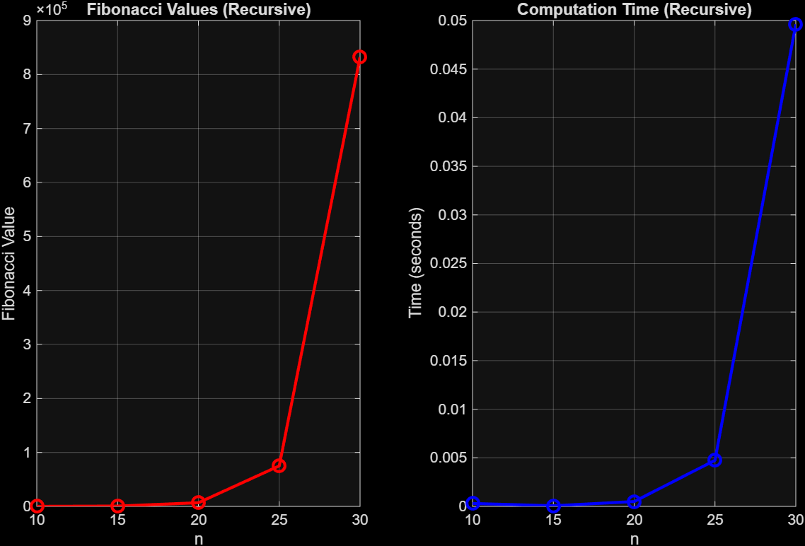
FIBONACCI RECURSIVE GRAPH

Slide 16
KNAPSACK RECURSIVE
% knapsack_recursive.m
function knapsack_recursive()
fprintf('=== Knapsack Problem (Recursive) ===\n');
% Test cases of different sizes
test_cases = {
{[2, 3, 4, 5], [3, 4, 5, 6], 5, 'Small'},
{[1, 3, 4, 5, 2], [1, 4, 5, 7, 3], 8, 'Medium'},
{[2, 1, 3, 4, 2, 5], [3, 2, 4, 5, 3, 6], 10, 'Large'}
};
times = zeros(length(test_cases), 1);
max_values = zeros(length(test_cases), 1);
for i = 1:length(test_cases)
weights = test_cases{i}{1};
values = test_cases{i}{2};
capacity = test_cases{i}{3};
case_name = test_cases{i}{4};
fprintf('\n%s Test Case:\n', case_name);
fprintf('Weights: '); fprintf('%d ', weights); fprintf('\n');
fprintf('Values: '); fprintf('%d ', values); fprintf('\n');
fprintf('Capacity: %d\n', capacity);
tic;
max_val = knapsack_recursive_func(weights, values, capacity, length(weights));
time_taken = toc;
times(i) = time_taken;
max_values(i) = max_val;
fprintf('Maximum value: %d\n', max_val);
fprintf('Computation time: %.6f seconds\n', time_taken);
end
% Plot results
figure;
subplot(1, 2, 1);
bar(max_values);
set(gca, 'XTickLabel', {'Small', 'Medium', 'Large'});
ylabel('Maximum Value');
title('Knapsack - Maximum Values');
grid on;
subplot(1, 2, 2);
bar(times);
set(gca, 'XTickLabel', {'Small', 'Medium', 'Large'});
ylabel('Time (seconds)');
title('Knapsack - Computation Time (Recursive)');
grid on;
% Save results
save("knapsack_recursive.mat", "times", "max_values", "test_cases");
end
function max_value = knapsack_recursive_func(weights, values, capacity, n)
% Base case
if n == 0 || capacity == 0
max_value = 0;
return;
end

Slide 17
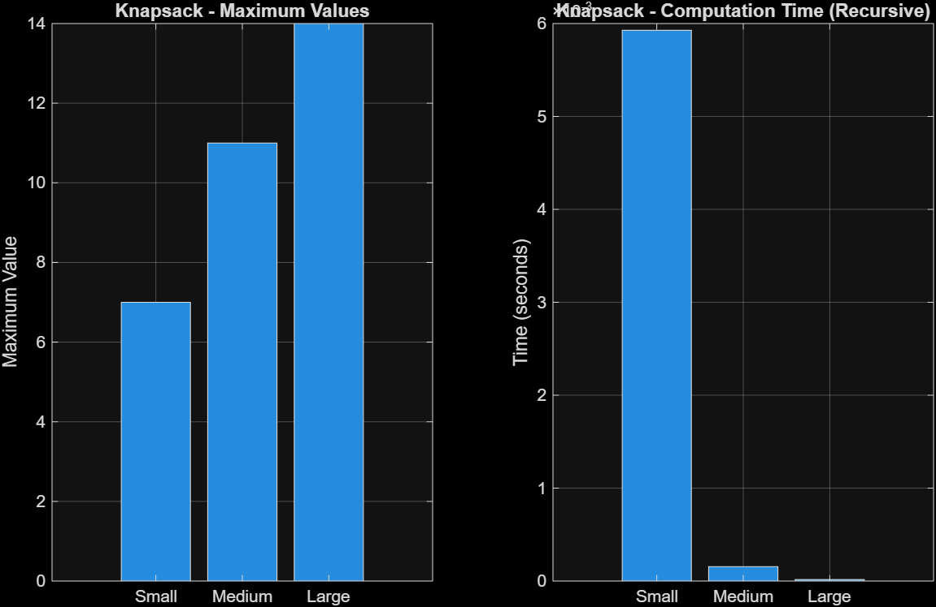
KNAPSACK RECURSIVE CONT.
% If weight of nth item is more than capacity, skip it
if weights(n) > capacity
max_value = knapsack_recursive_func(weights, values, capacity, n-1);
return;
end
% Return maximum of two cases:
% (1) nth item included
% (2) nth item not included
include = values(n) + knapsack_recursive_func(weights, values, capacity - weights(n), n-1);
exclude = knapsack_recursive_func(weights, values, capacity, n-1);
max_value = max(include, exclude);
end

Slide 18
FIBONACCI DYNAMIC PROGRAMMING
% fibonacci_dp.m
function fibonacci_dp()
fprintf('=== Fibonacci Problem (Dynamic Programming) ===\n');
% Test different n values
n_values = [10, 15, 20, 25, 30, 35, 40, 45, 50];
times = zeros(size(n_values));
fib_values = zeros(size(n_values));
for i = 1:length(n_values)
n = n_values(i);
fprintf('\nCalculating F(%d)...\n', n);
tic;
fib_val = fibonacci_dp_func(n);
time_taken = toc;
times(i) = time_taken;
fib_values(i) = fib_val;
fprintf('F(%d) = %d\n', n, fib_val);
fprintf('Computation time: %.6f seconds\n', time_taken);
end
% Plot results
figure;
subplot(1, 2, 1);
semilogy(n_values, fib_values, 'ro-', 'LineWidth', 2, 'MarkerSize', 8);
xlabel('n');
ylabel('Fibonacci Value (Log Scale)');
title('Fibonacci Values (DP) - Log Scale');
grid on;
subplot(1, 2, 2);
plot(n_values, times, 'bo-', 'LineWidth', 2, 'MarkerSize', 8);
xlabel('n');
ylabel('Time (seconds)');
title('Computation Time (DP)');
grid on;
% Save results
save("fibonacci_dp.mat", "n_values", "times", "fib_values");
end
function fib = fibonacci_dp_func(n)
if n <= 1
fib = n;
return;
end
fib_vals = zeros(1, n+1);
fib_vals(1) = 0;
fib_vals(2) = 1;
for i = 3:n+1
fib_vals(i) = fib_vals(i-1) + fib_vals(i-2);
end
fib = fib_vals(n+1);
end

Slide 19
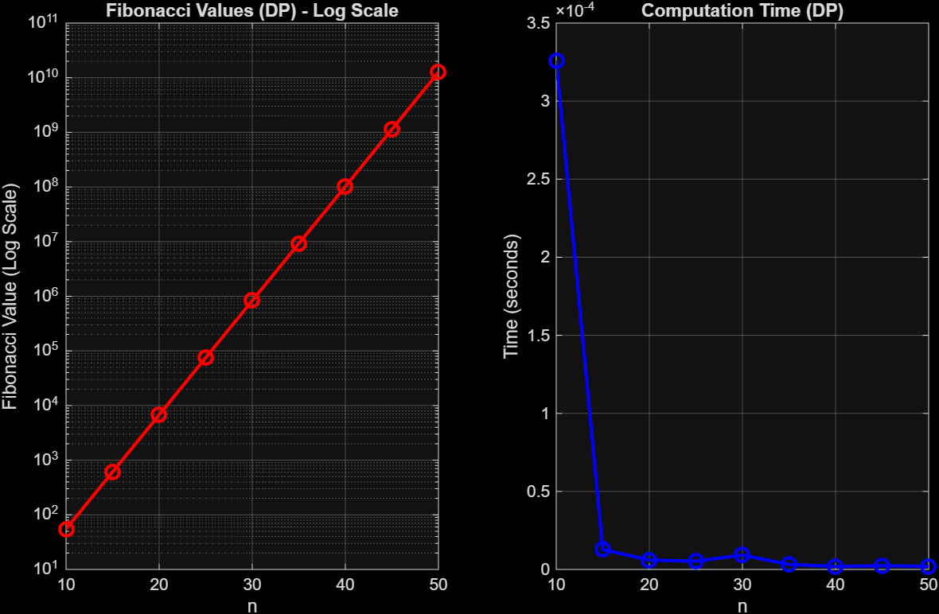
FIBONACCI DYNAMIC GRAPH

Slide 20
KNAPSACK DYNAMIC
% knapsack_dp.m
function knapsack_dp()
fprintf('=== Knapsack Problem (Dynamic Programming) ===\n');
% Test cases of different sizes
test_cases = {
{[2, 3, 4, 5], [3, 4, 5, 6], 5, 'Small'},
{[1, 3, 4, 5, 2], [1, 4, 5, 7, 3], 8, 'Medium'},
{[2, 1, 3, 4, 2, 5], [3, 2, 4, 5, 3, 6], 10, 'Large'}
};
times = zeros(length(test_cases), 1);
max_values = zeros(length(test_cases), 1);
for i = 1:length(test_cases)
weights = test_cases{i}{1};
values = test_cases{i}{2};
capacity = test_cases{i}{3};
case_name = test_cases{i}{4};
fprintf('\n%s Test Case:\n', case_name);
fprintf('Weights: '); fprintf('%d ', weights); fprintf('\n');
fprintf('Values: '); fprintf('%d ', values); fprintf('\n');
fprintf('Capacity: %d\n', capacity);
tic;
max_val = knapsack_dp_func(weights, values, capacity);
time_taken = toc;
times(i) = time_taken;
max_values(i) = max_val;
fprintf('Maximum value: %d\n', max_val);
fprintf('Computation time: %.6f seconds\n', time_taken);
end
% Plot results
figure;
subplot(1, 2, 1);
bar(max_values);
set(gca, 'XTickLabel', {'Small', 'Medium', 'Large'});
ylabel('Maximum Value');
title('Knapsack - Maximum Values');
grid on;
subplot(1, 2, 2);
bar(times);
set(gca, 'XTickLabel', {'Small', 'Medium', 'Large'});
ylabel('Time (seconds)');
title('Knapsack - Computation Time (DP)');
grid on;
dp(i, w) = dp(i-1, w);
end
end
end
max_value = dp(n+1, capacity+1);
end

Slide 21
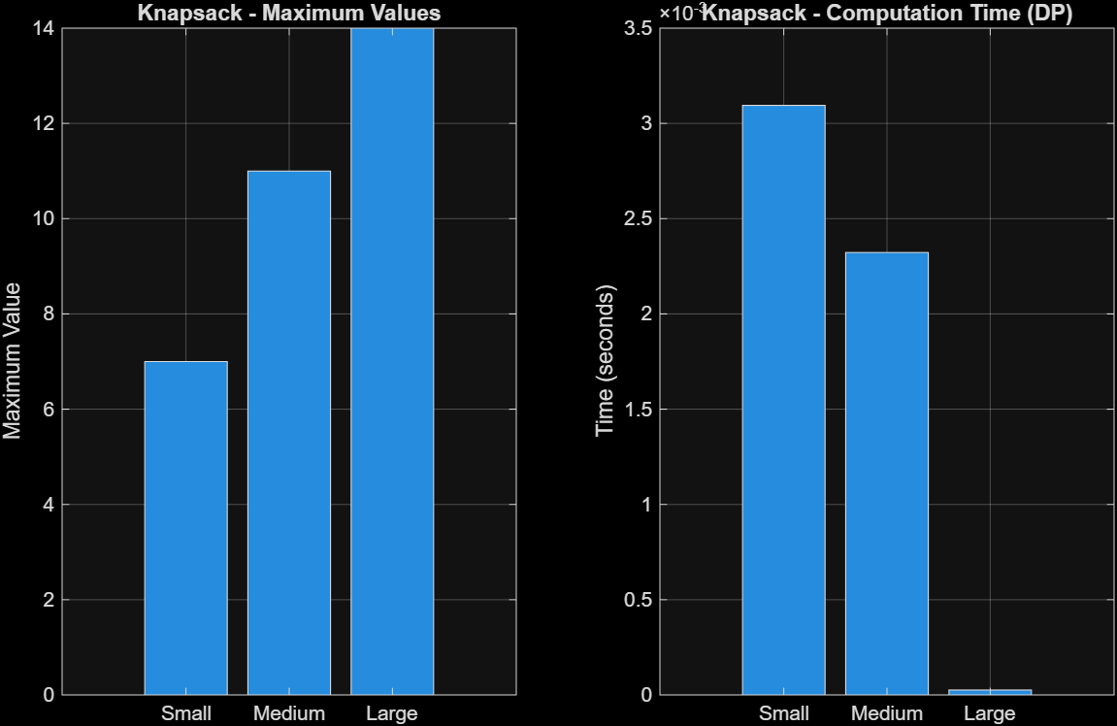
KNAPSACK DYNAMIC CONT.
% Save results
save("knapsack_dp.mat", "times", "max_values", "test_cases");
end
function max_value = knapsack_dp_func(weights, values, capacity)
n = length(weights);
% Create DP table
dp = zeros(n+1, capacity+1);
for i = 1:n+1
for w = 1:capacity+1
if i == 1 || w == 1
dp(i, w) = 0;
elseif weights(i-1) <= w-1
dp(i, w) = max(values(i-1) + dp(i-1, w-weights(i-1)), dp(i-1, w));
else

Slide 22
CONCLUSION
We managed to make equivalent code based on recursive programming and using the concept of recursive and dynamic programming, we were able to solve the problems of Knapsack ad Fibonacci and make drafts comparing their computation times.

